Slide 1

HSE-Perm, UDC 09.03.04, Faculty of Economics, management and business Informatics, Department of information technology in business
TEXT
The work was performed by a 1st year student of ПИ-18-2 group, faculty of economics, management and business informatics
Chepokov E. S.
Perm’, 2019

Slide 2

Outline
Text
Perm, 2019
Чепоков Елизар Сергеевич
In title

Slide 3
Text
Text
Perm, 2019
Чепоков Елизар Сергеевич
In title

Slide 4
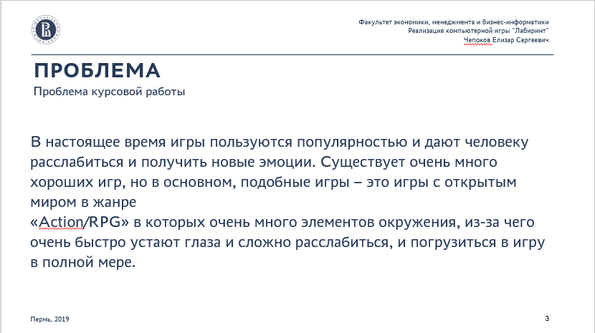
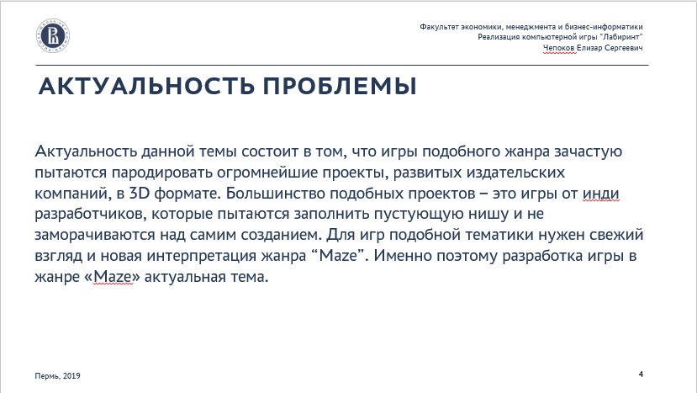
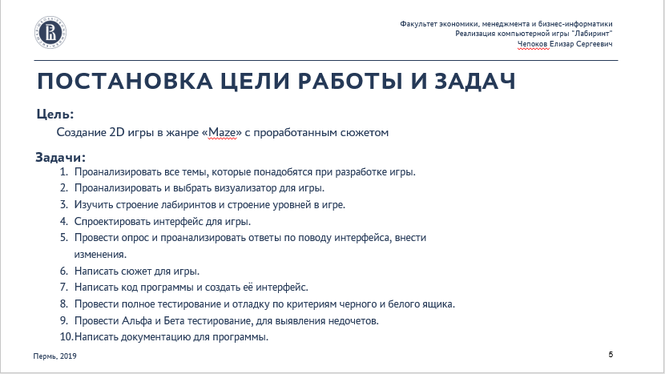





Contents list
3
4
5
6
7
8
9
10

Slide 5
THANK YOU FOR YOUR ATTENTION
WE ARE GLAD TO ANSWER YOUR QUESTIONS
Autor: Chepokov E. S.
Phone number: +7 (951) 959 4666
E-mail: eschepokov@edu.hse.ru

